Slide 1


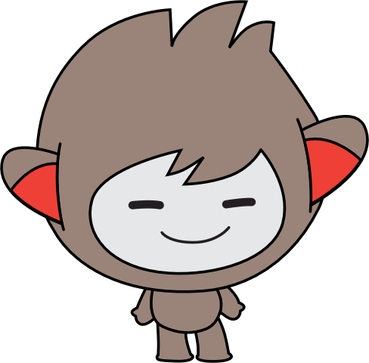


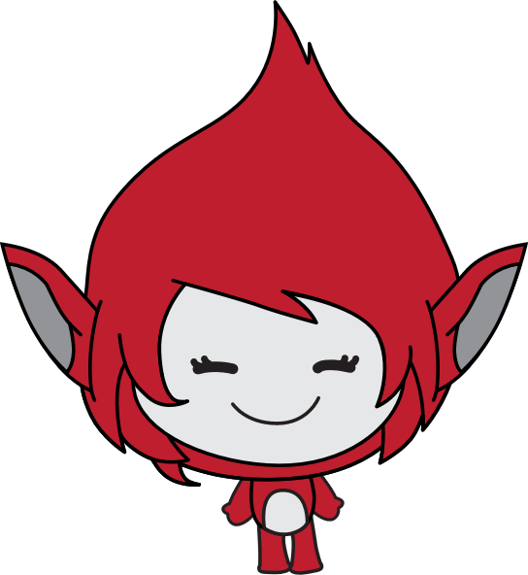
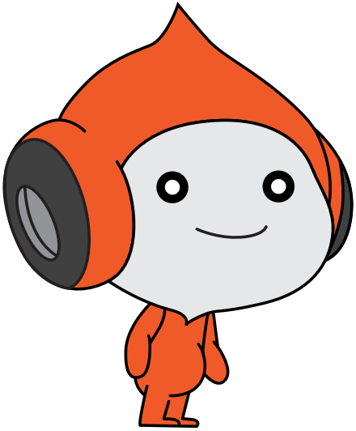
Lesson 1:
space talk

Slide 2
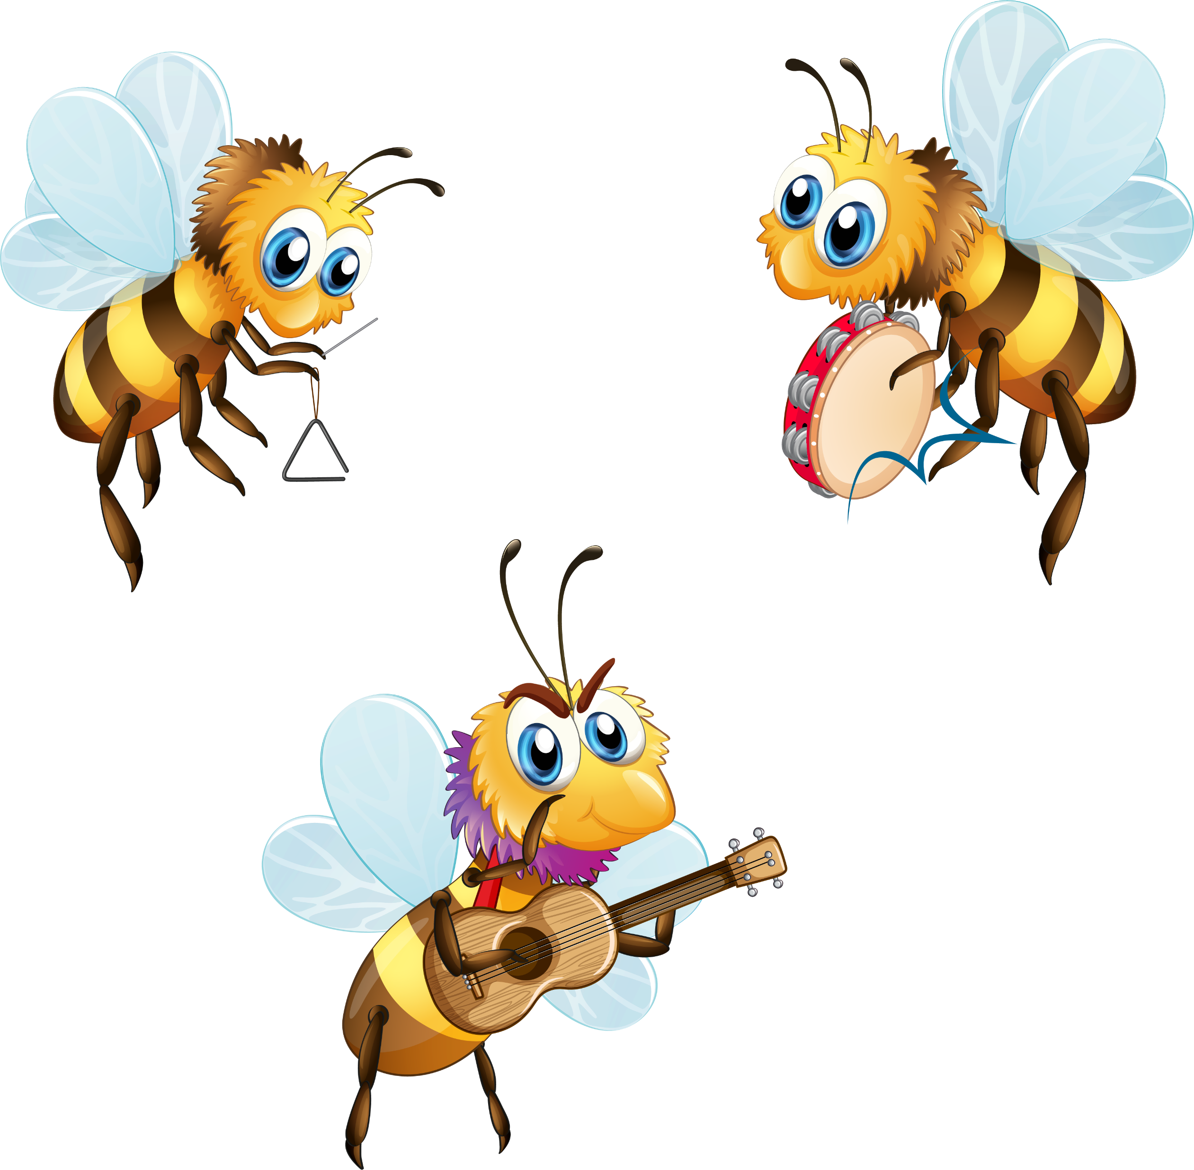
Bee dance…

Slide 3
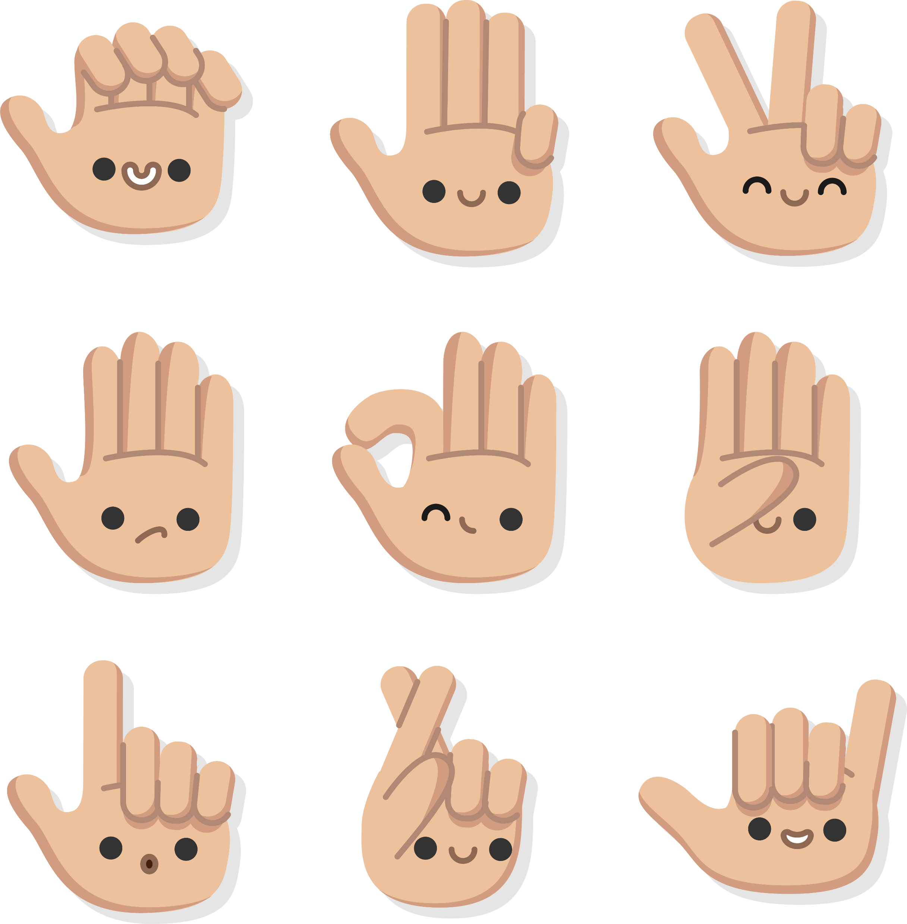
Sign language

Slide 4
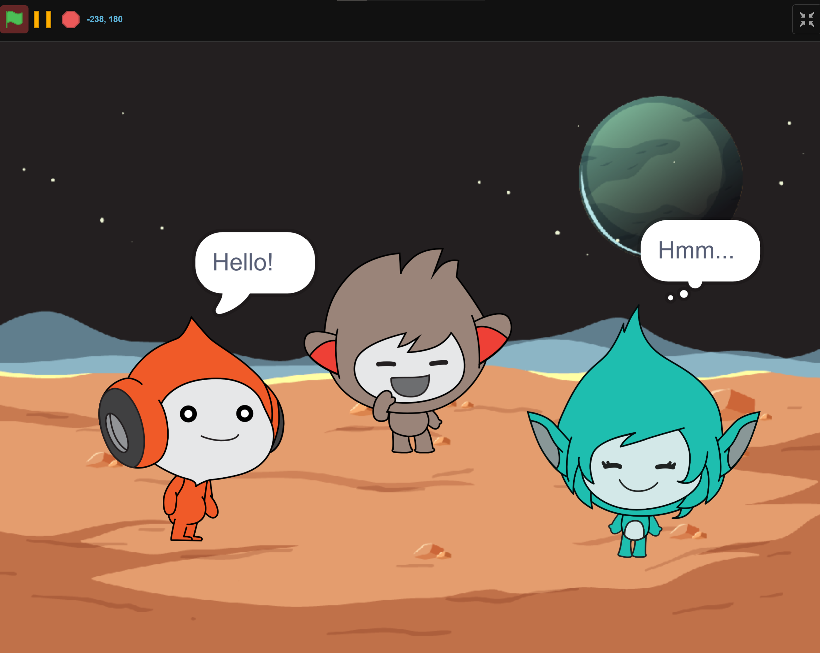
What we will Create…

Slide 5

Course FIles
Notes
Lesson 1
…
Resources
Level 1
Scratch for Newbies
Level 2
Lesson 6
Level 3

Slide 6
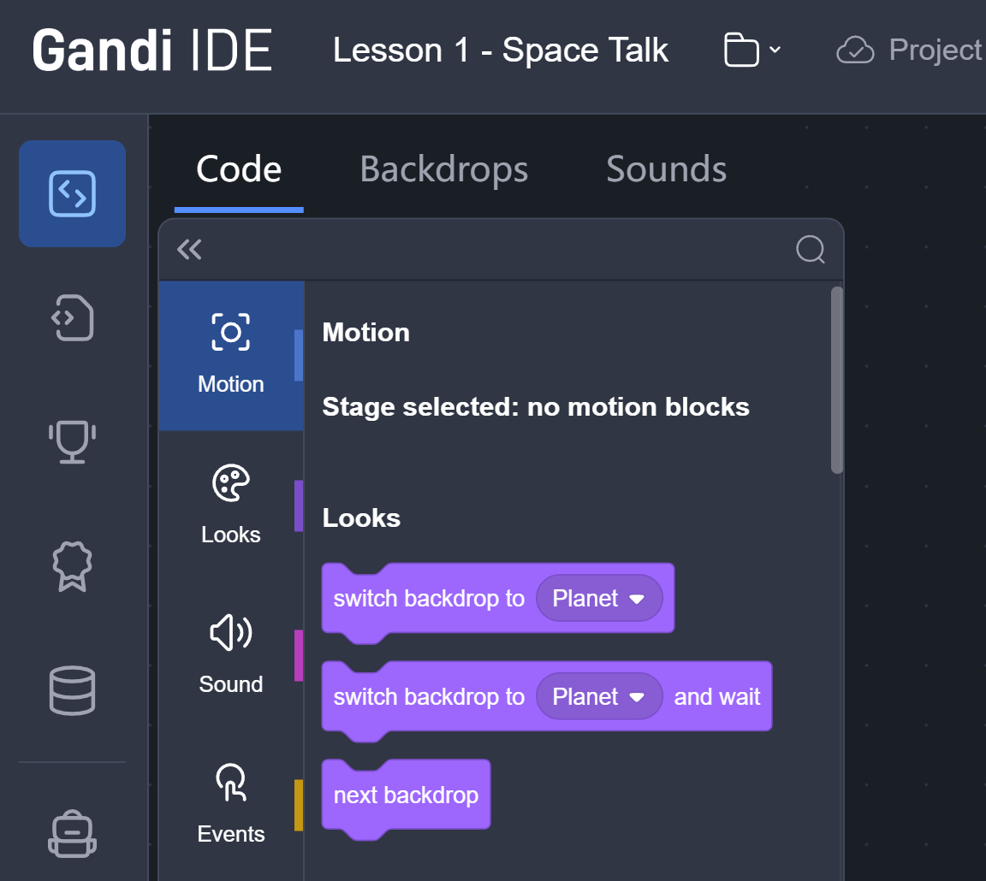
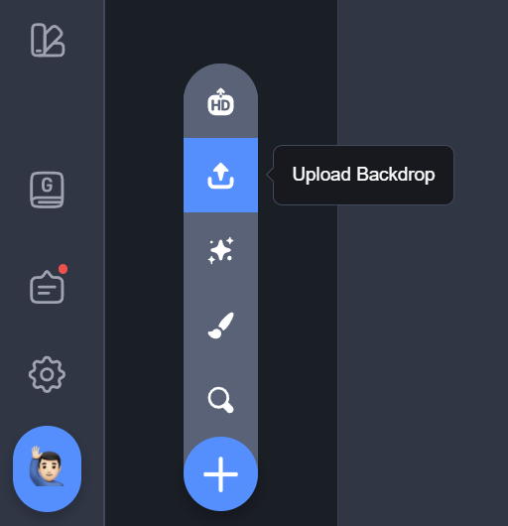
Upload backdrop

Slide 7
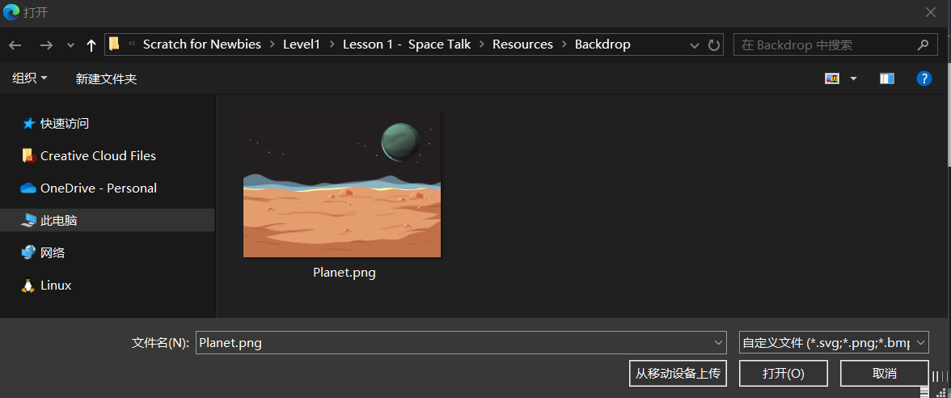
Upload backdrop
File Explorer

Slide 8
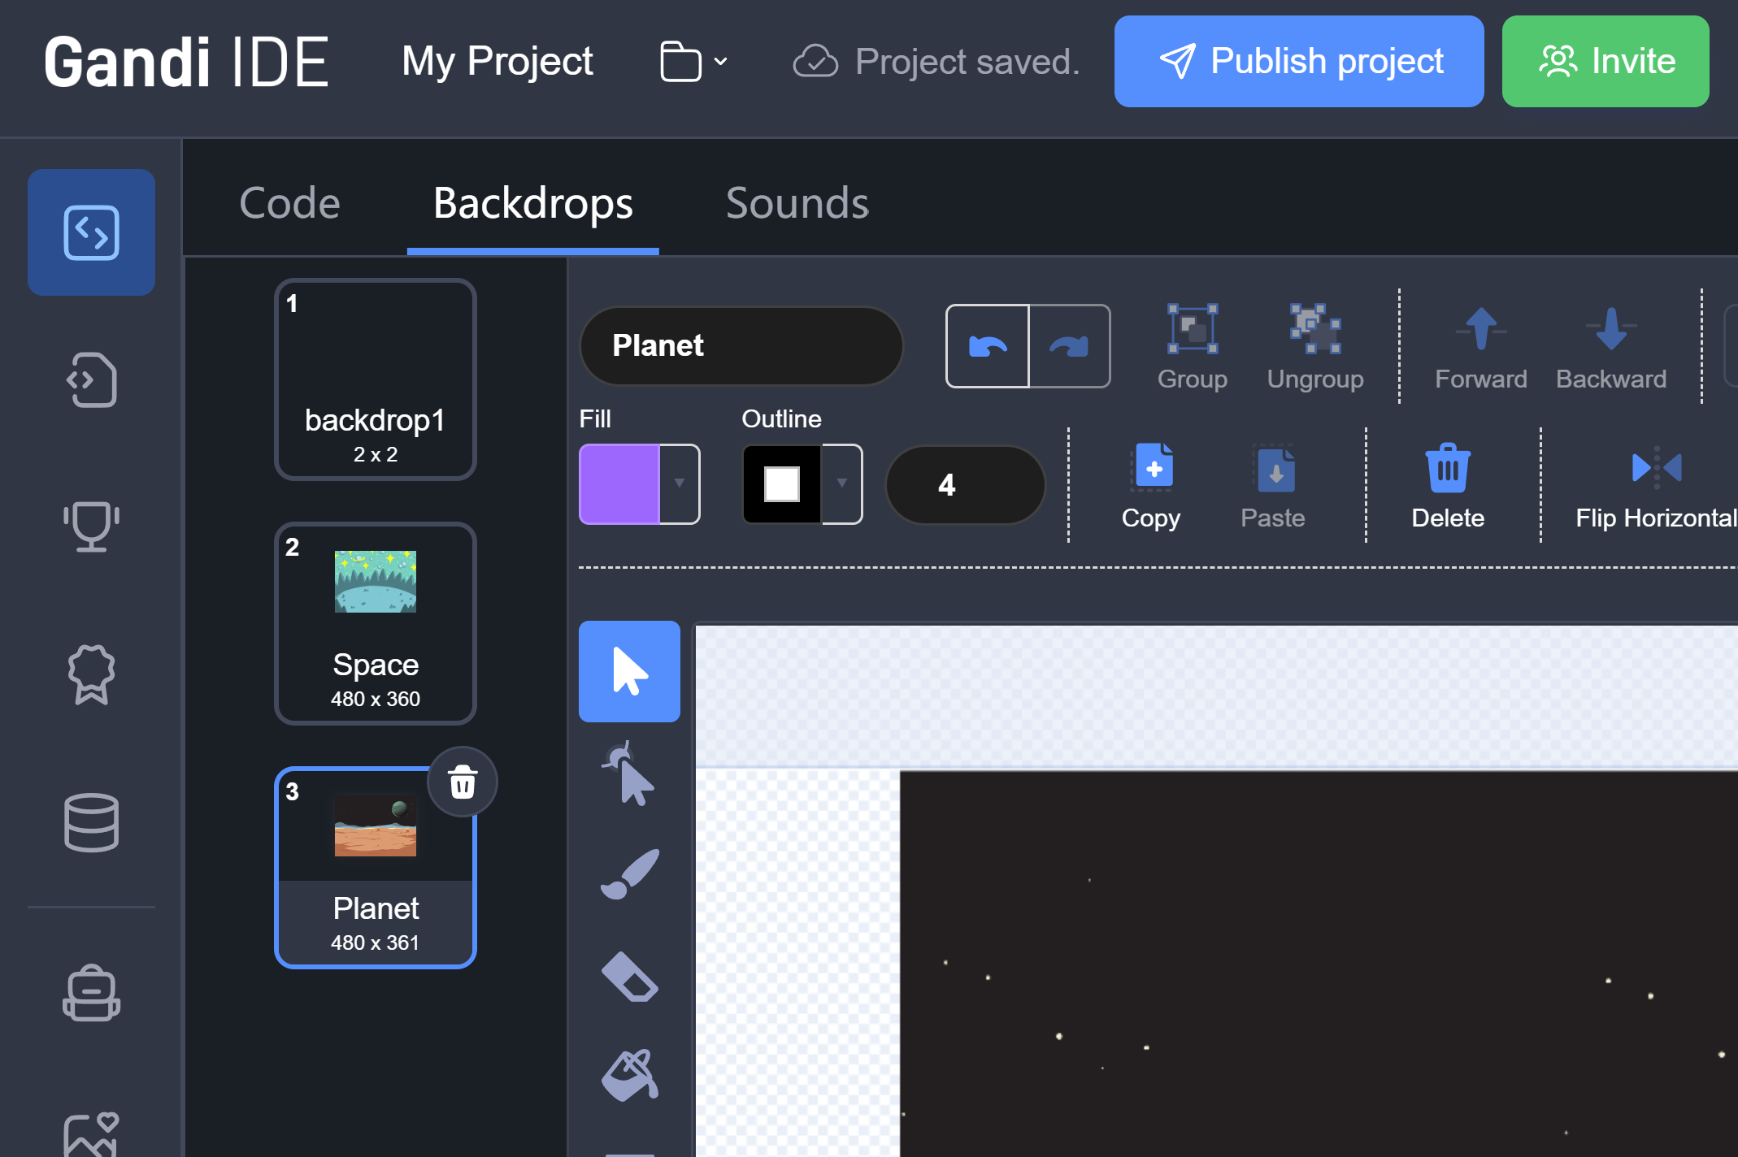
Upload backdrop

Slide 9
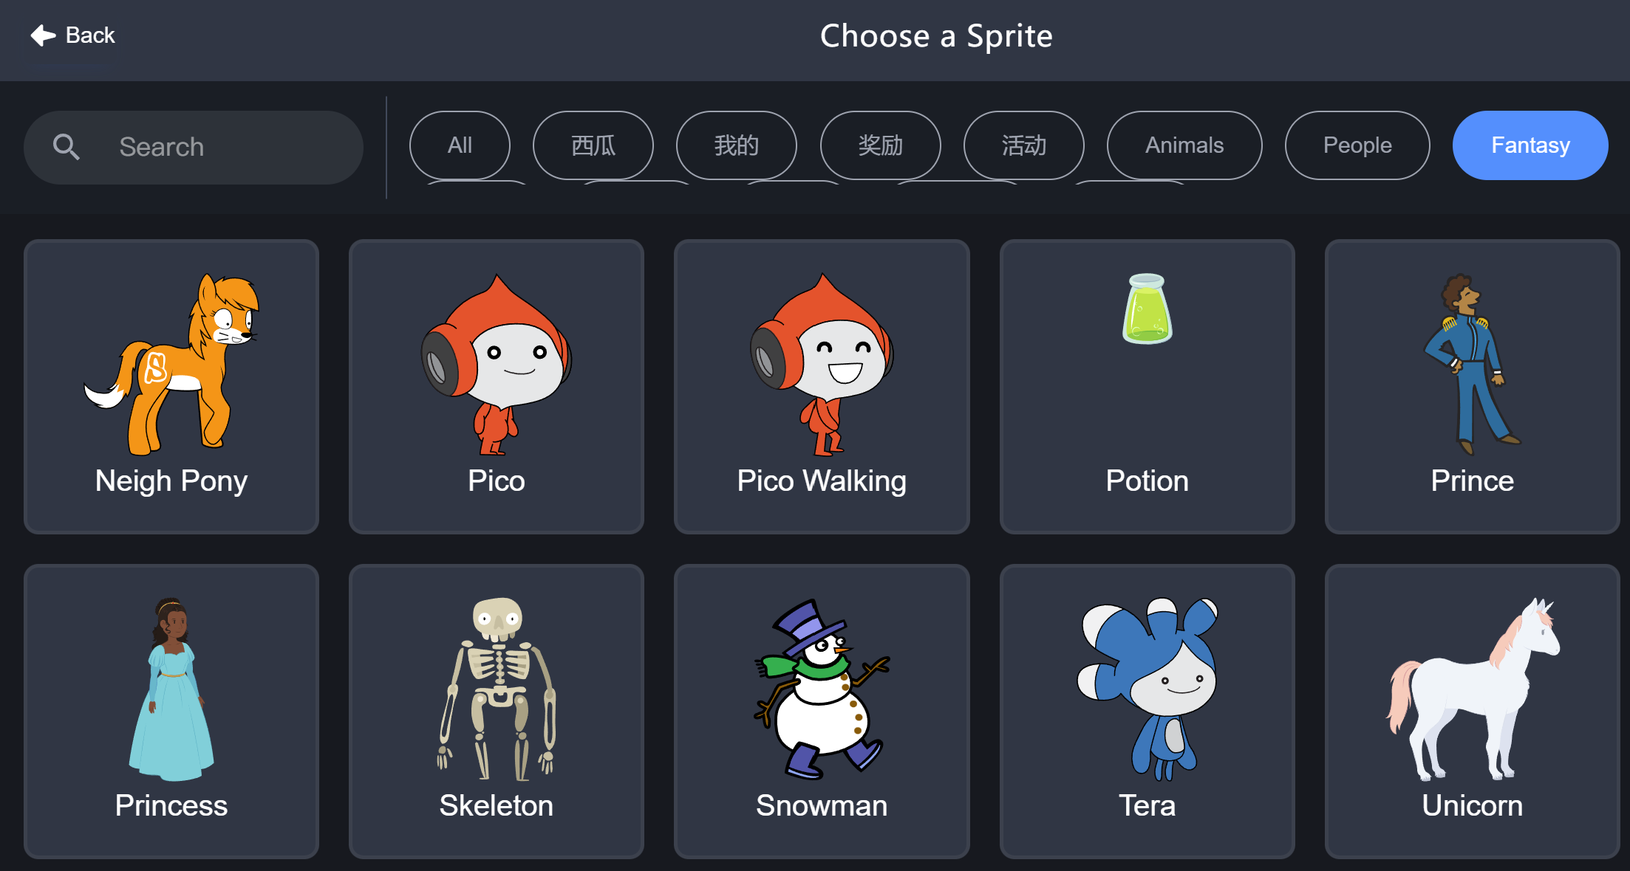
Pico

Slide 10


Pico says hello
2 seconds

Slide 11


Pico says hello

Slide 12


Pico says hello

Slide 13
Pico says hello

Slide 14
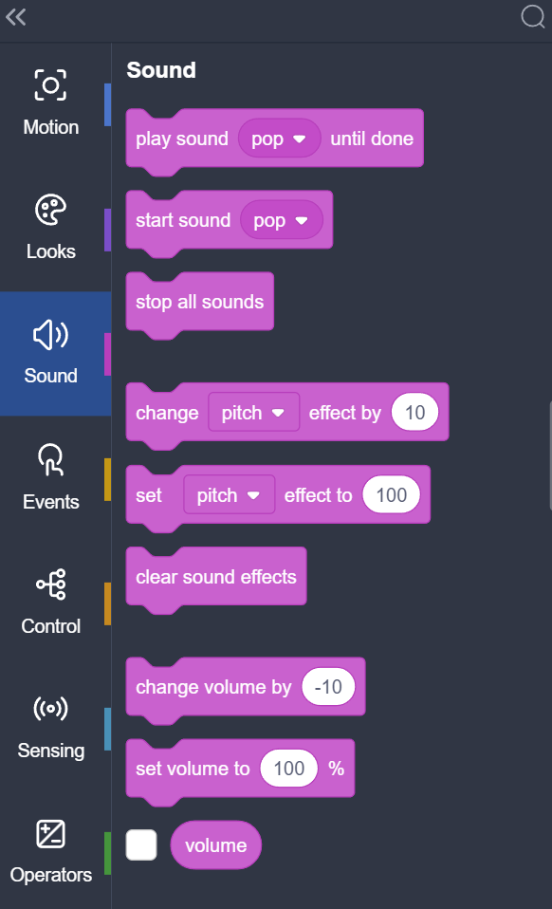
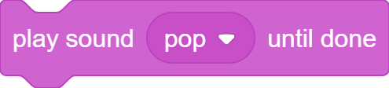

Pico Makes a sound

Slide 15
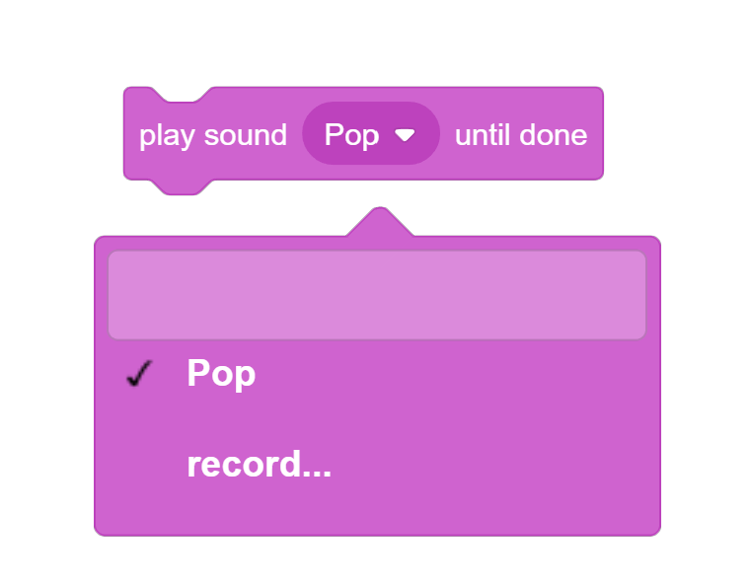

Pico Makes a sound

Slide 16
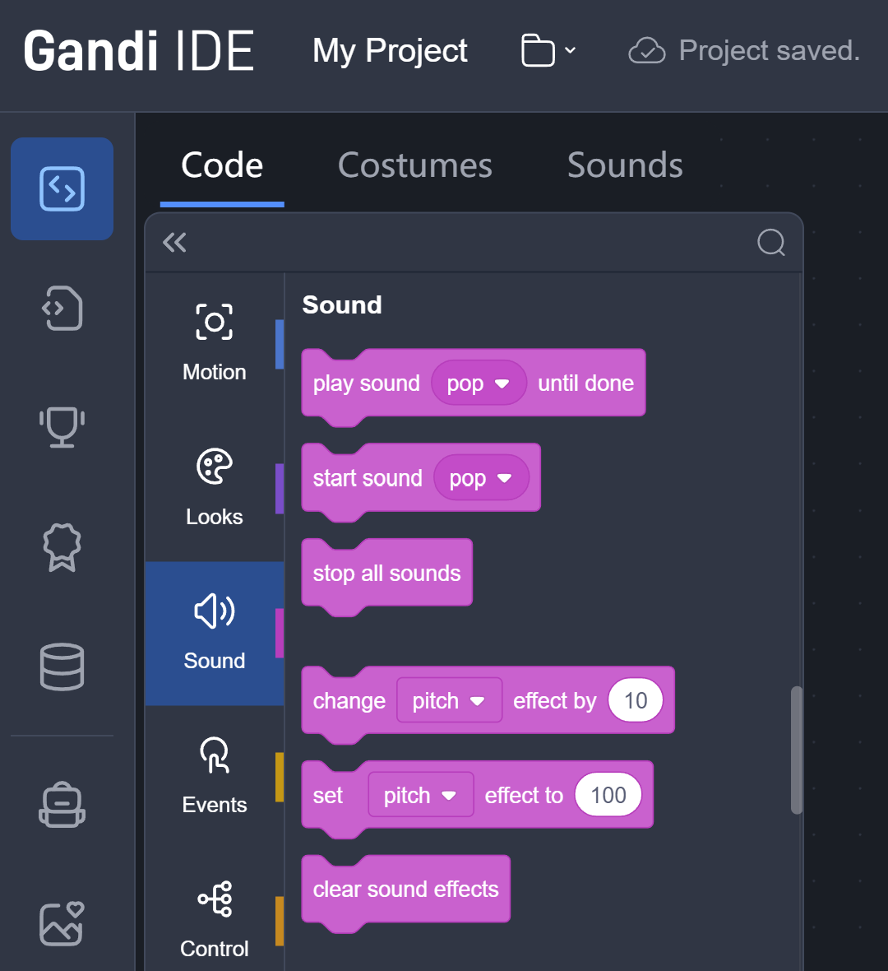
Pico Makes a sound

Slide 17
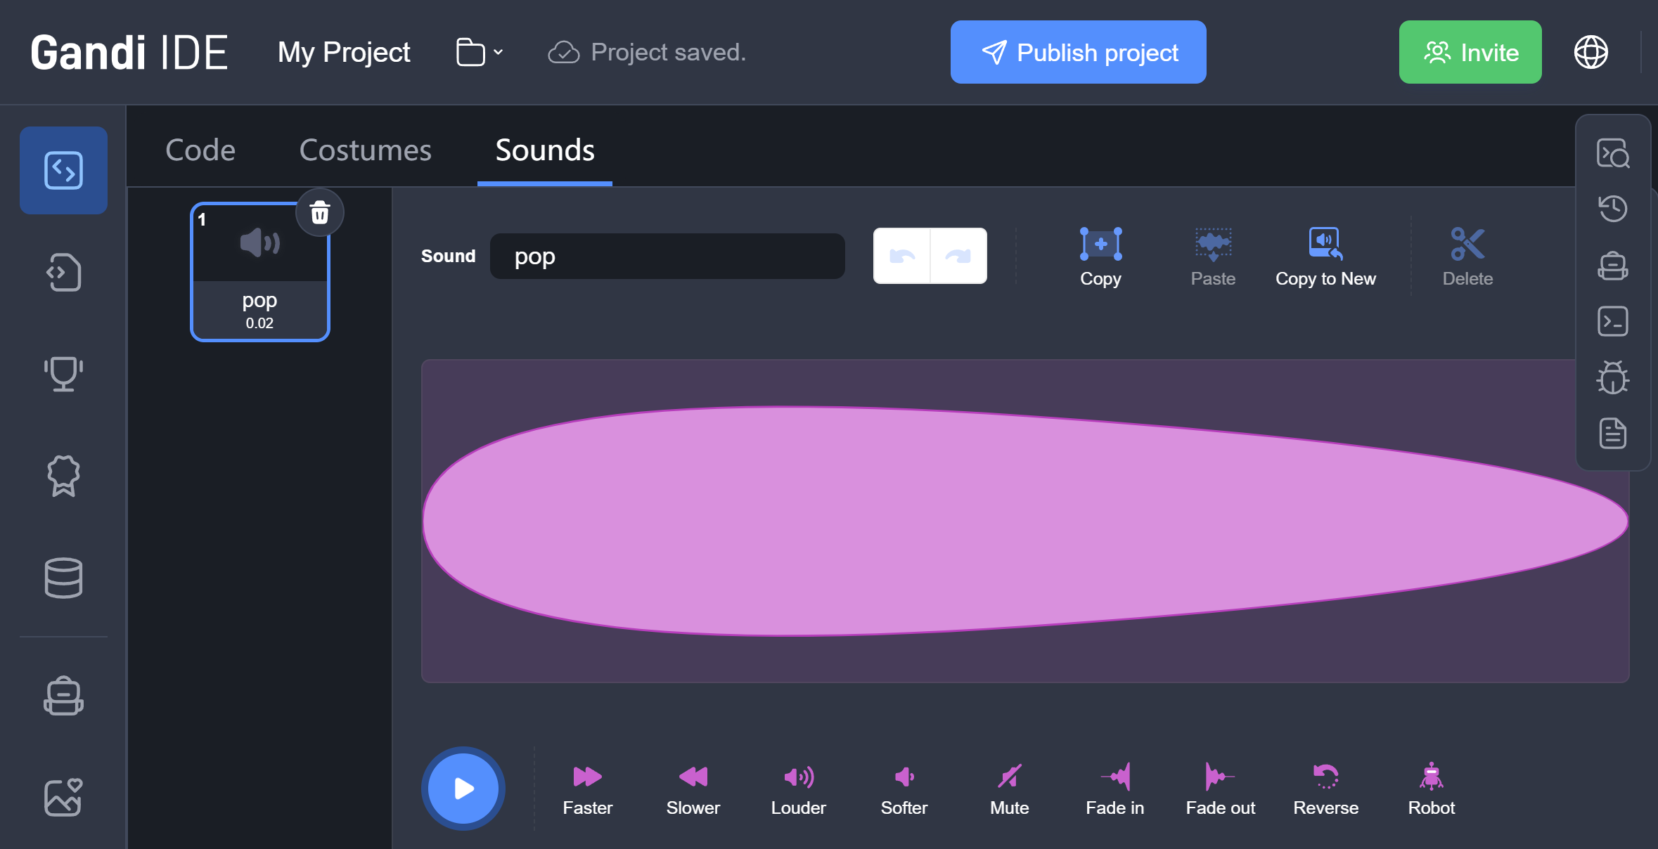
Pico Makes a sound

Slide 18
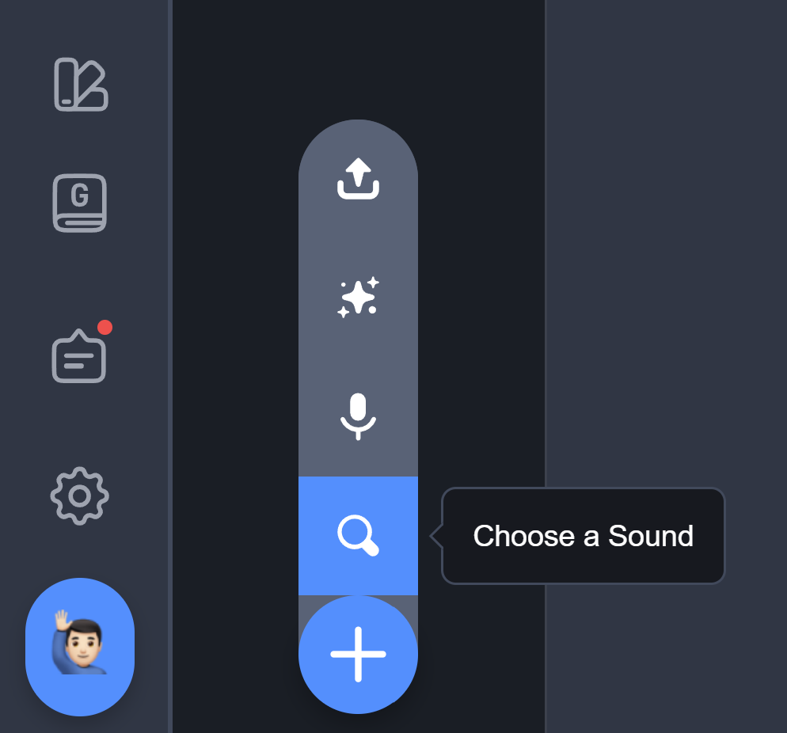
Pico Makes a sound

Slide 19
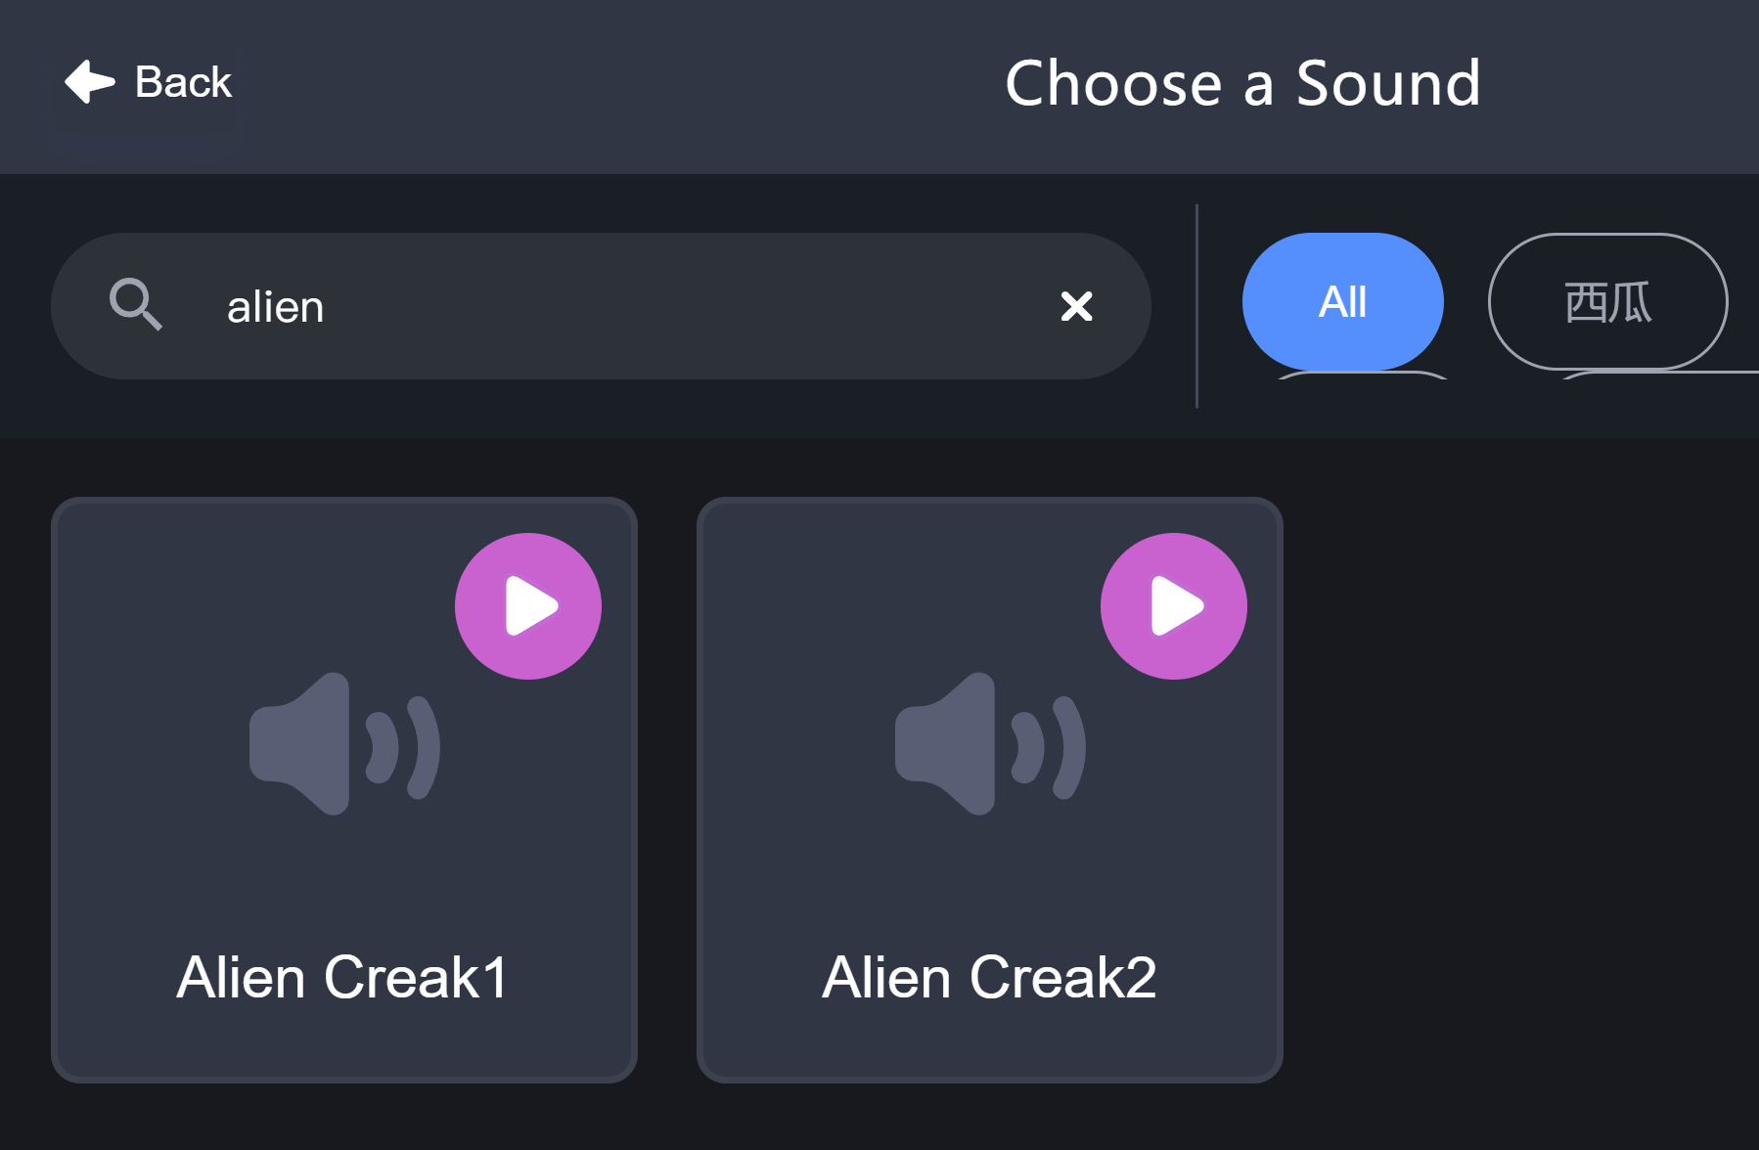
Pico Makes a sound

Slide 20
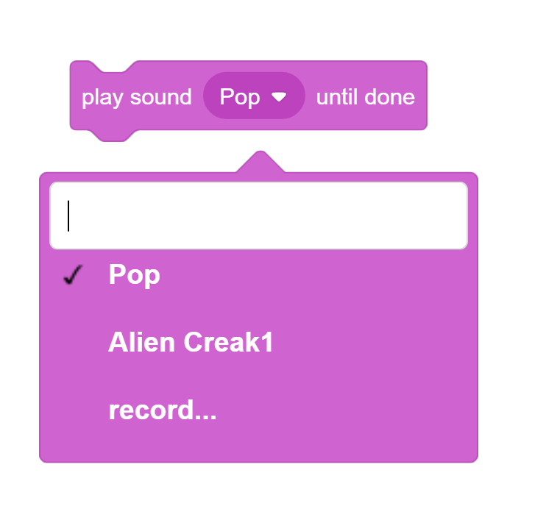
Pico Makes a sound

Slide 21
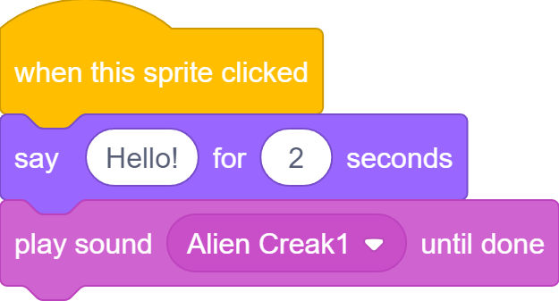
Pico Makes a sound

